Slide 1

HR Attrition data analysis
By: Ashley Littles

Slide 2
Introduction
Our organization is rapidly expanding, and management has noticed that the employees have a newfound lack of engagement and job satisfaction.
We are noticing the employees are leaving their jobs. To determine why we are to analyze the HR attrition data and create metrics to figure out why.
We will work to highlight anything that could be causing attrition to be worse.

Slide 3
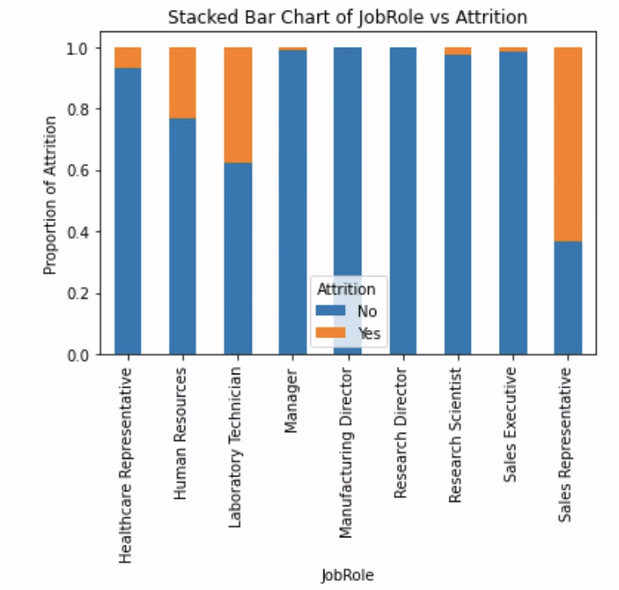
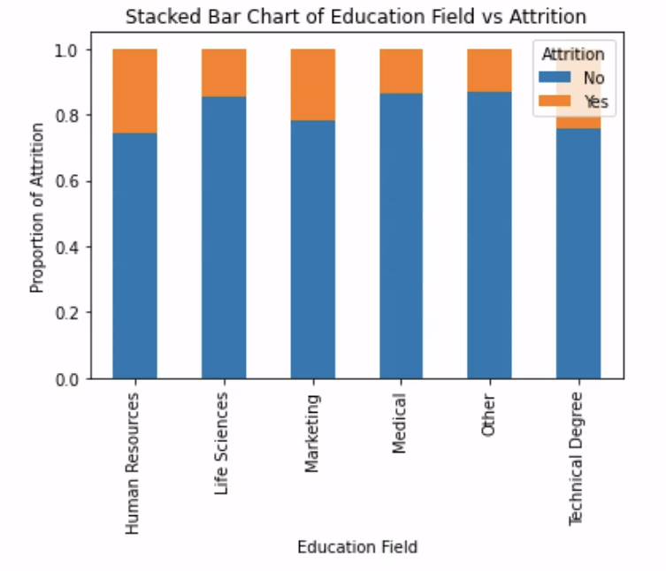
Visualizations
Two stacked bar charts were created to display the attrition related factors.
The first stacked bar chart shows job role compared to proportion of attrition.
The second stacked bar chart shows education field compared to proportion of attrition.

Slide 4
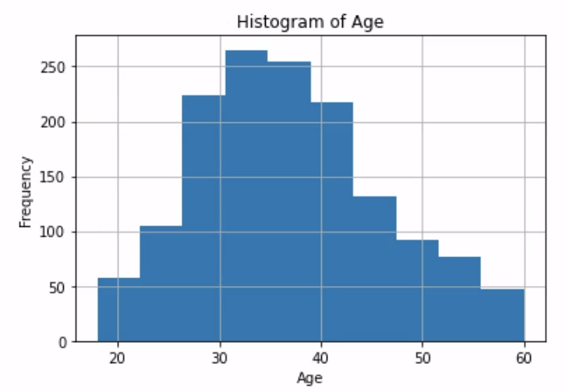
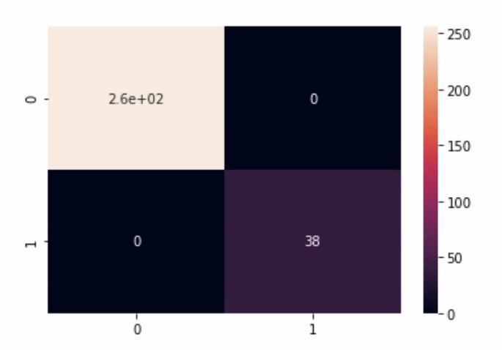
Visualization
To take a deeper look at the data I created a histogram and heatmap.
The histogram chart shows age against frequency.
The heatmap will visualize our confusion matrix results of the actual values compared to the predicted values.

Slide 5

Conclusion
Diving deeply into performance ratings can be a difficult task. Knowing all of the features and variables of the data set as well as having quality visuals can aid in accurately predicating the outcomes we are looking for based on the data.

